Slide 1

Optimization of Travelling Salesperson Problem by Genetic Algorithm
Presented by – Pranab Kumar Paul

Slide 2
Introduction
The travelling salesman problem asks the following question: "Given a list of cities and the distances between each pair of cities, what is the shortest possible route that visits each city exactly once and returns to the origin city?"
Modelled as an undirected weighted graph, G=(V,E) that has a nonnegative integer cost c(u,v) associated with each edge (u,v) Є E such that cities : vertices, paths : edges, and a path's distance : edge's weight.
It is a minimization problem starting and finishing at a specified vertex after having visited each other vertex exactly once.

Slide 3
Motivation
two approaches to solve a TSP: Brute Force methods and heuristic methods.
TSP is a NP complete problem requires 𝑂(𝑛!) time for brute force solution.
By dynamic programming it is solved in 𝑂(2^{𝑛}𝑛²) time which is still exponential time complexity.
So here we use Genetic algorithm which is a heuristic approach to solve TSP because of its flexibility and robustness and to get a near by optimal solution with in less time.

Slide 4
Idea Behind Genetic Algorithm
Based on Darwin’s Principle of Natural Selection.
Darwin’s principle of Natural Selection can be stated as “Survival of the fittest”.
Genetic algorithms use techniques inspired by evolutionary biology such as inheritance, mutation, selection, and crossover.
The evolution process stops when some predefined termination condition is satisfied. At each intermediate stage, the old generation is replaced by the new generation.

Slide 5
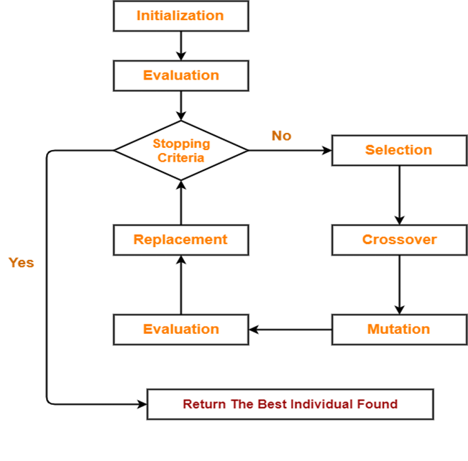
The algorithm
Procedure GA:
Step 1. Initialize the population: current population & Evaluate.
Step 2. Repeat step 3 through step 5 till termination condition is satisfied.
Step 3. Apply selection to obtain the mating pool.
Step 4. Crossover and Mutate the mating pool to generate
The new population.
Step 5. Replace the current population by the new population.
Step 6. Return the best solution of the current population.

Slide 6
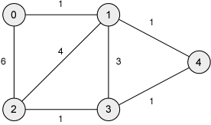
Mapping with TSP
There are certain features associated with a GA. These are,
1. The chromosomes.
2. Fitness function to evaluate each solution.
3. Population size i.e., Initial population.
4. The mating pool, i.e., the set of chromosomes after selection.
5. GA operators, e.g., selection, crossover, and mutation.
6. Various GA parameters, e.g., crossover probability (pc), mutation probability (pμ).
7. Termination condition.

Slide 7
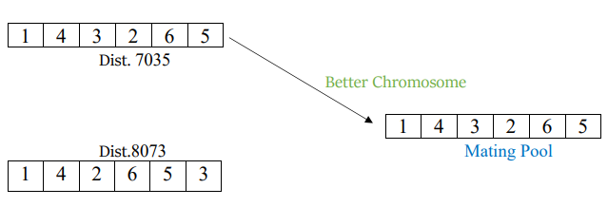
Selection
Tournament selection.
Selection based on Fitness value.

Slide 8
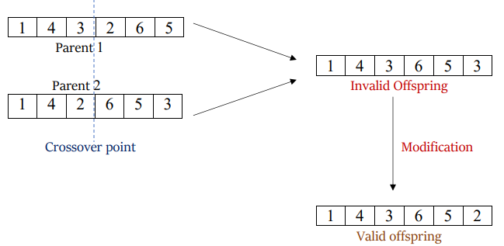
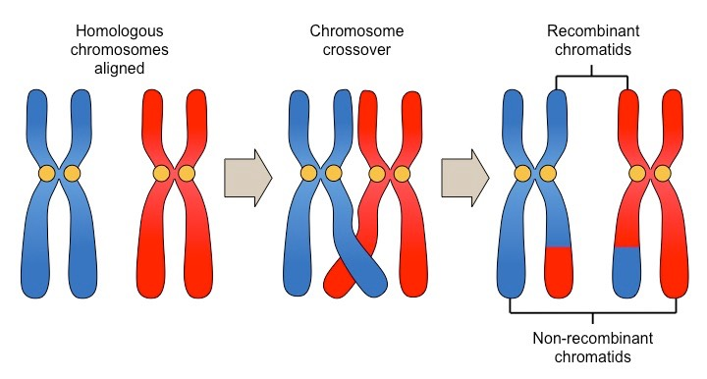
Crossover
Here we use the Single point crossover [6]method.
may produce some invalid offspring.

Slide 9
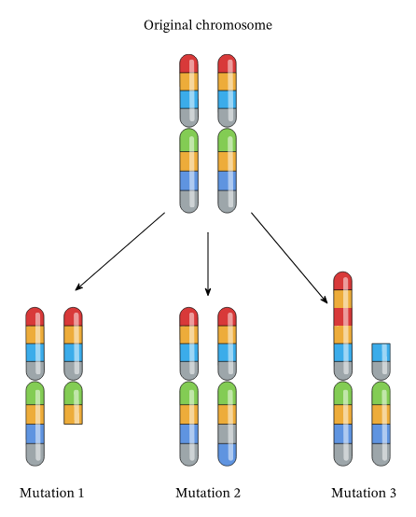
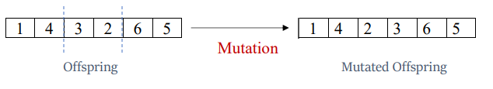
Mutation
randomly selecting any two cities and flipping [3] [5] their cities in between them.

Slide 10
Termination Condition
Here I implemented terminating condition as follows, if the minimum fitness value of the population does not change for the 100 iterations, then the algorithm will converge and give the solution as the best tour length and the city sequences i.e., best chromosome.

Slide 11
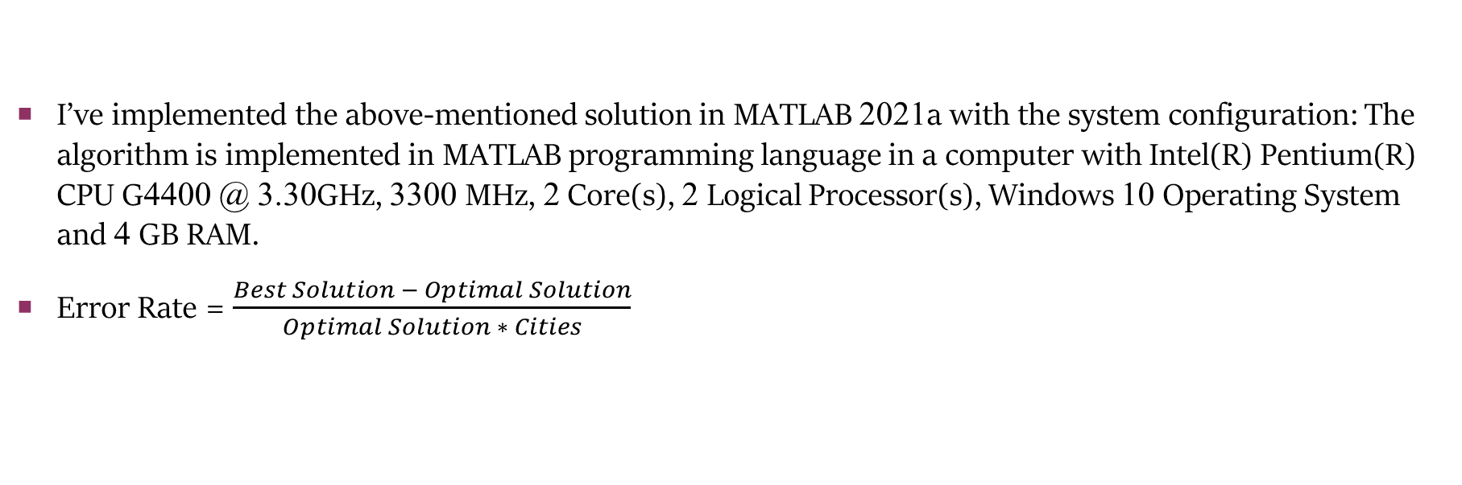
Results
I’ve implemented the above-mentioned solution in MATLAB 2021a with the system configuration: The algorithm is implemented in MATLAB programming language in a computer with Intel(R) Pentium(R) CPU G4400 @ 3.30GHz, 3300 MHz, 2 Core(s), 2 Logical Processor(s), Windows 10 Operating System and 4 GB RAM.
Error Rate = $\frac{Best Solution − Optimal Solution}{Optimal Solution ∗ Cities}$

Slide 12
Results(cont.…)
Inputs are taken from these TSP Libraries:
TSP - Data for the Traveling Salesperson Problem (fsu.edu).
CITIES - City Distance Datasets (fsu.edu).
National Traveling Salesman Problems (uwaterloo.ca).
jorlib/jorlib-core/src/test/resources/tspLib/tsp at master · coin-or/jorlib · GitHub

Slide 13
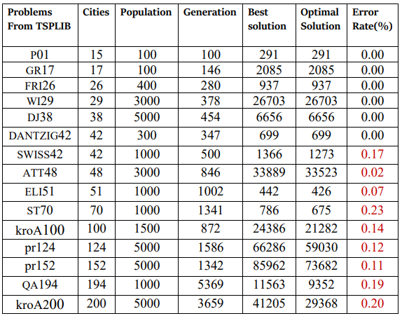
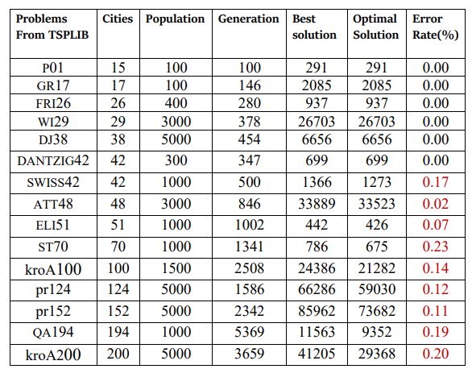
Results(cont.…)

Slide 14
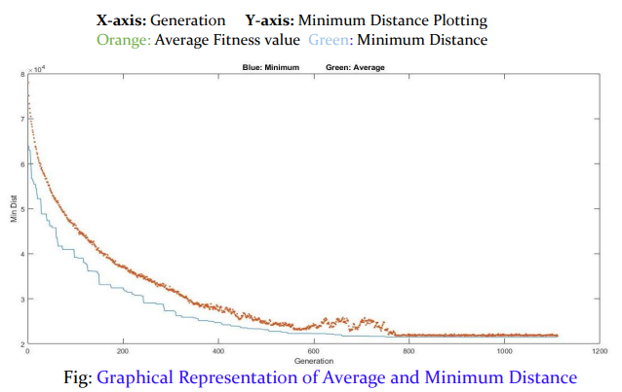
Graphical representation

Slide 15
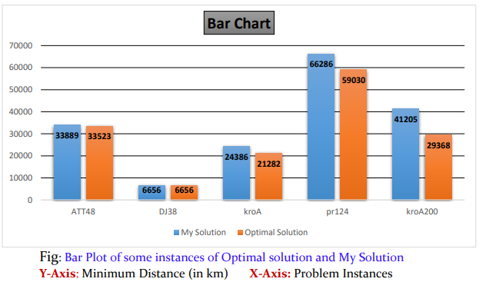
Bar chart

Slide 16
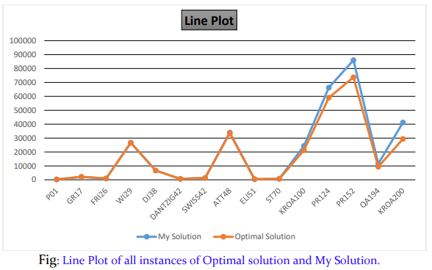
Line Plot

Slide 17
Conclusion
By combining the knowledge of GAs for solving TSP is an optimistic approach. Depending on the manner, the problem is encoded and which crossover and mutation methods are used, genetic algorithm find fine solutions for the travelling salesman problem. Through this paper our objective is to give a more effective process for solving TSP by using the genetic algorithm. In this paper we have solved the symmetric TSP but in future we would like to optimize this solution to more accurate and try to solve asymmetric TSP as well.

Slide 18
Acknowledgement
I want to sincerely thank my supervisor Prof. Priya Ranjan Sinha Mahapatra and Dr. Soumen Atta and Prof. Anirban Mukhopadhyay for encouraging me and helping me out at each and every step of this work. Again, I want to thank to permit me in Research LAB, KU for supporting this project.

Slide 19
References
[1] (PDF) "Solving Travelling Salesman problem by New Optimization Algorithm" (researchgate.net).
[2]Introduction-to-soft-computing-neuro-fuzzy-and-genetic-algorithms-by-samir-roy-udit-chakraborthy.
[3] An Introduction to Genetic Algorithms:Method and Implementation (Anirban Mukhopadhyay).
[5] Adewole Philip, AkinwaleAdioTaofiki and OtunbanowoKehinde, “A Genetic Algorithm for Solving Travelling Salesman Problem”, International Journal of Advanced Computer Science and Applications, 2011, Vol. (2), No. (1).
[6] R. Poli and W. B. Langdon. “Genetic Programming with One-point Crossover and Point Mutation”. Technical Report CSRP-97-13, University of Birmingham, School of Computer Science, Birmingham, B15 2TT, UK, 15 Apr. 1997.
[7] Exploring Travelling Salesman Problem using Genetic Algorithm (ijert.org).
[8] (46) An Introduction to Genetic Algorithms: Method and Implementation (Lecture 1) by Anirban Mukhopadyay – YouTube.

Slide 20


